Slide 1
What is Quantum Computing?
Dr. Moshiur Rahman
Stevens Institute of Technology

Slide 2
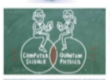
Overview
Explanation of Quantum Computing and comparing it to digital/classical computing.
Computer Science + Quantum Physics

Slide 3
Nobody understands quantum mechanics
“No, you’re not going to be able to understand it. . . . You see, my physics students don’t understand it either. That is because I don’t understand it. Nobody does. ... The theory of quantum electrodynamics describes Nature as absurd from the point of view of common sense. And it agrees fully with an experiment. So I hope that you can accept Nature as She is -- absurd.
Richard Feynman

Slide 4
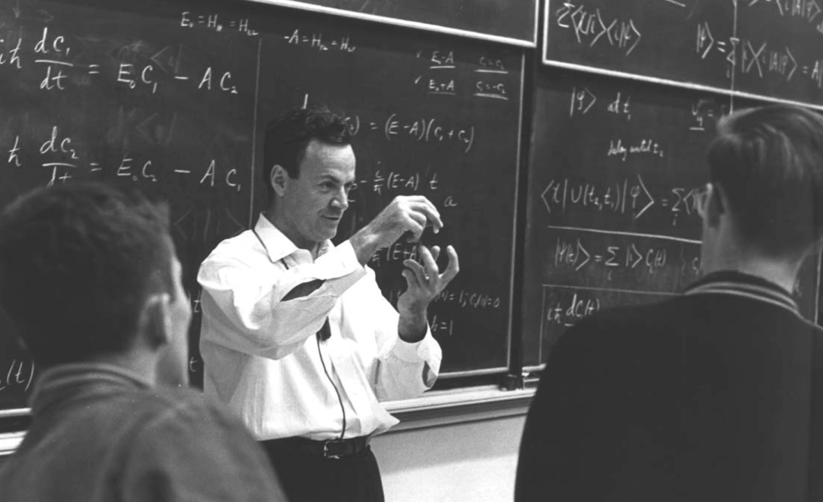
“Nature isn’t classical, dammit, and if you want to make a simulation of nature, you’d better make it quantum mechanical, and by golly, it’s a wonderful problem, because it doesn’t look so easy.”
- Richard P. Feynman

Slide 5
The Three Current Models
Quantum Gates & Circuits
IBM (50 Qubits)
Google’s Bristlecone (72 Qubits)
Google’s Quantum Supremacy –Sycamore processor 53 qubits
IonQ (79 trapped ion Qubits & 160 stored Qubits)
Rigetti Quantum Cloud (36 Qubits)
2. Quantum Annealing Devices
D-Wave systems - first commercial computer with customers
NASA, USC, Lockheed-Martin, Google, LANL, etc.
3. Quantum Walks (on graphs)
4. Quantum simulators (inspired by Quantum Phenomenon)
Fujitsu Digital Annealer uses a digital circuit design
Hitachi Complementary Metal Oxide Semiconductor (CMOS) annealing
Microsoft 40-Qubit Azure

Slide 6
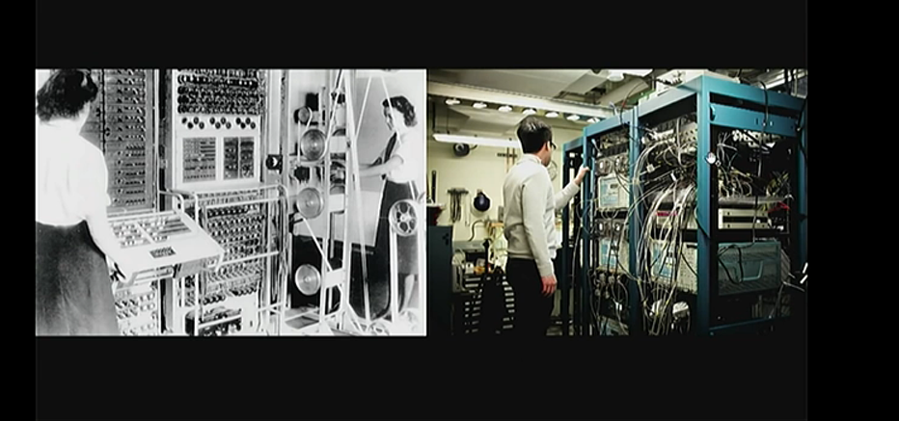
Classical Computers

Slide 7
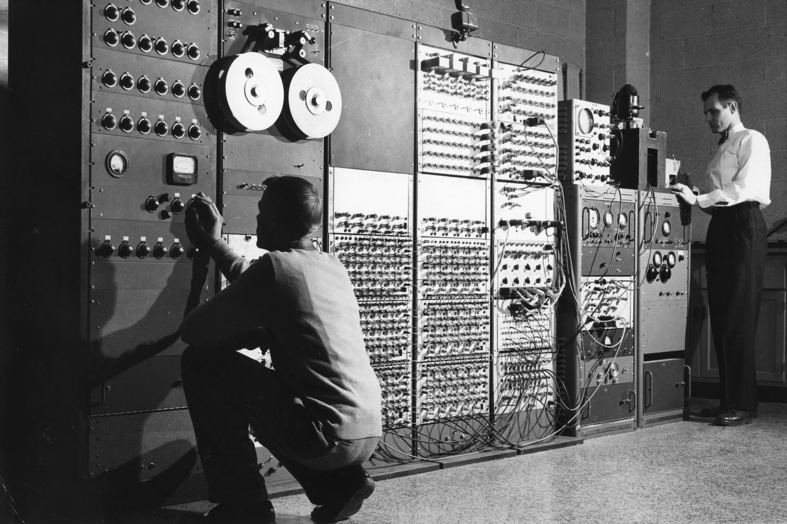
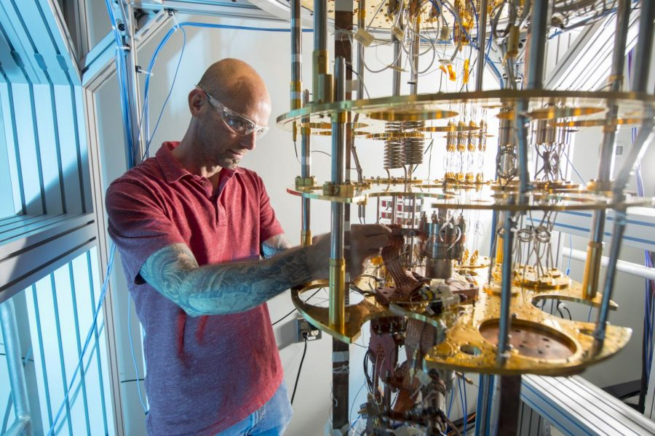
Evolution from Digital to Quantum

Slide 8
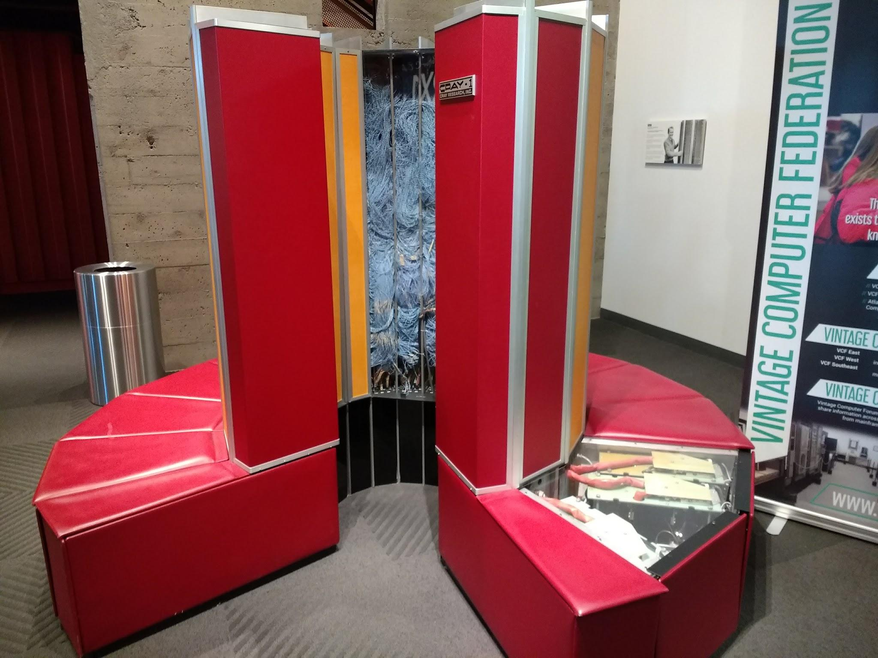
Cray 1

Slide 9
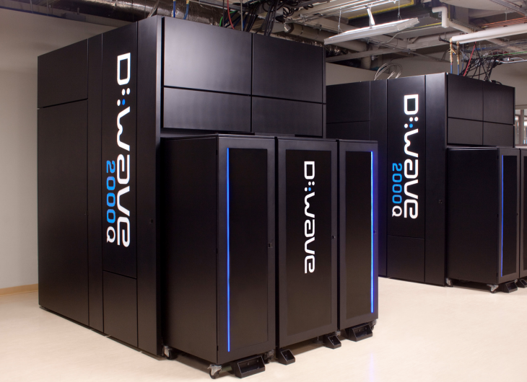
D-Wave

Slide 10
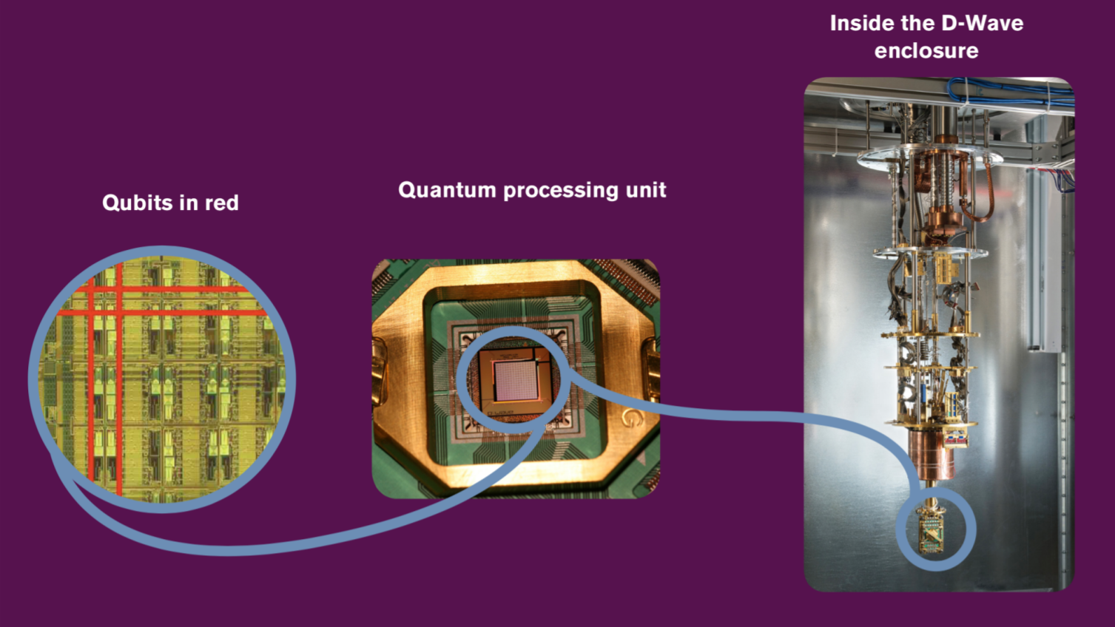

Slide 11
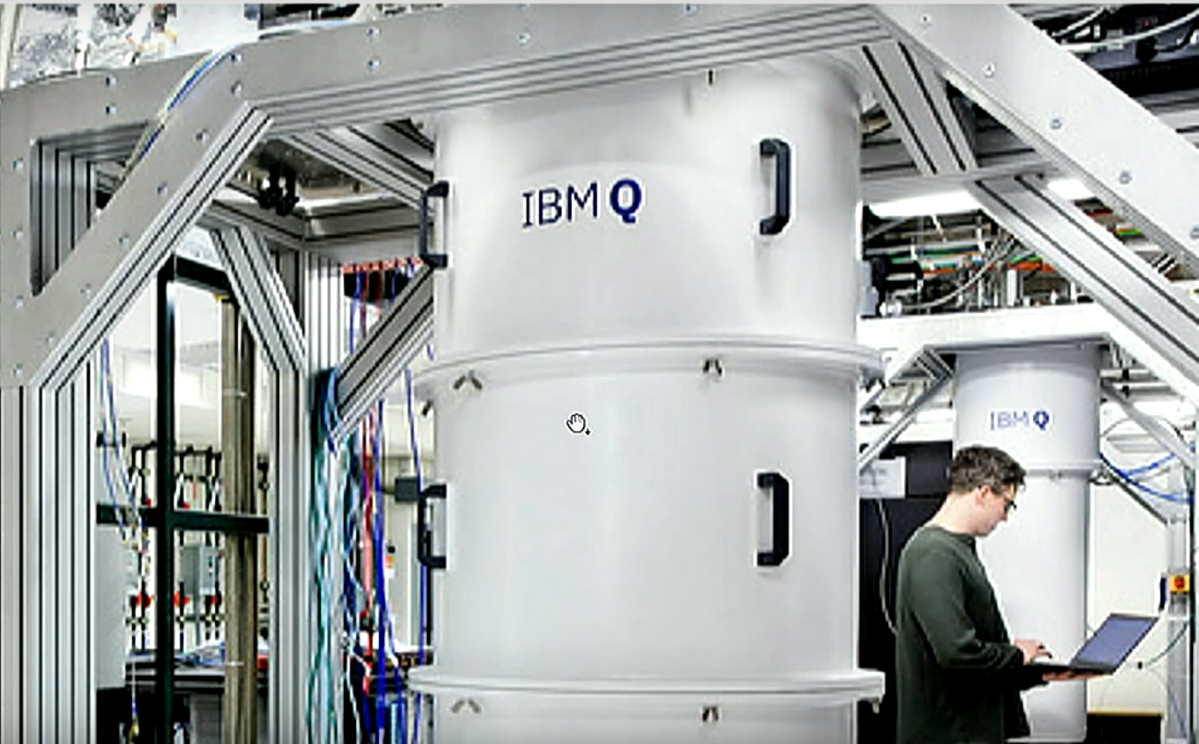
IBM

Slide 12
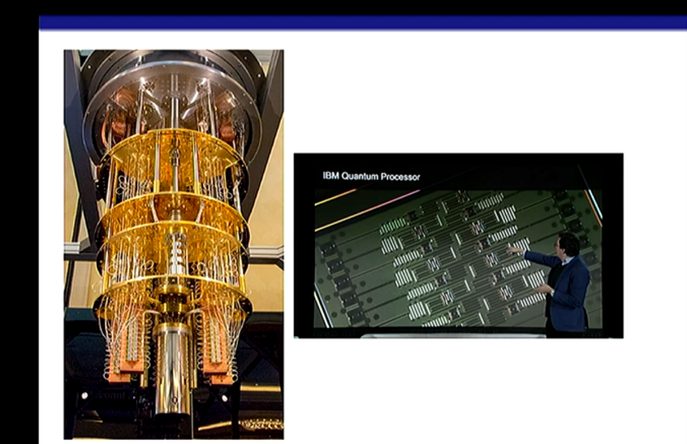
IBM

Slide 13
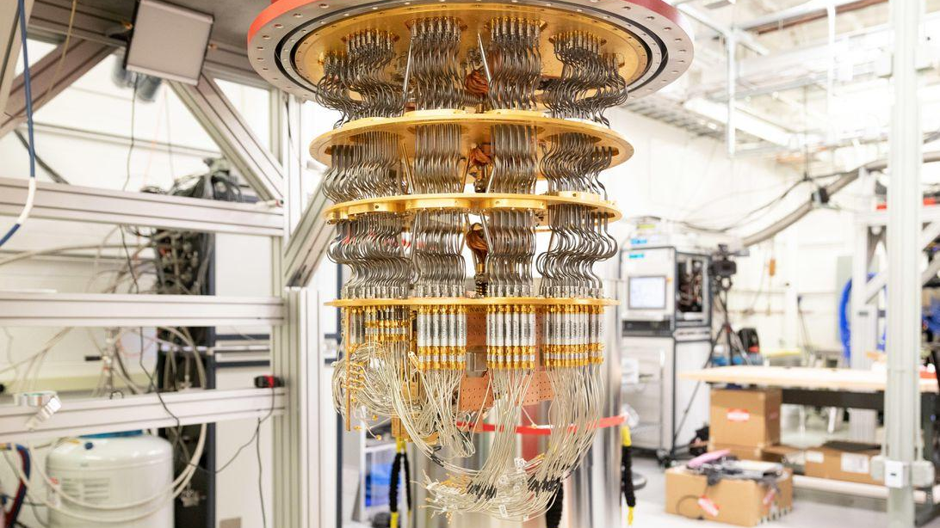

Slide 14

Google Quantum Computer
Google’s quantum supremacy
is only a first test of a computing
revolution
“Quantum Supremacy” is nice,
but more broadly useful quantum
computers are probably still a
decade away

Slide 15
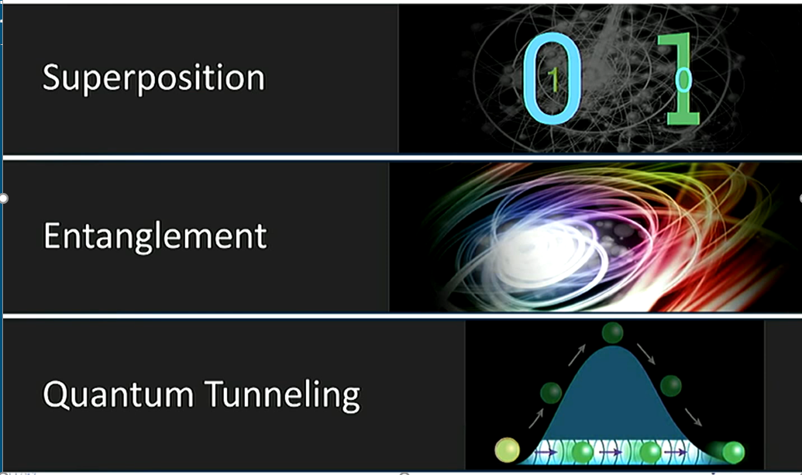
Quantum Features Beyond Digital Computing

Slide 16
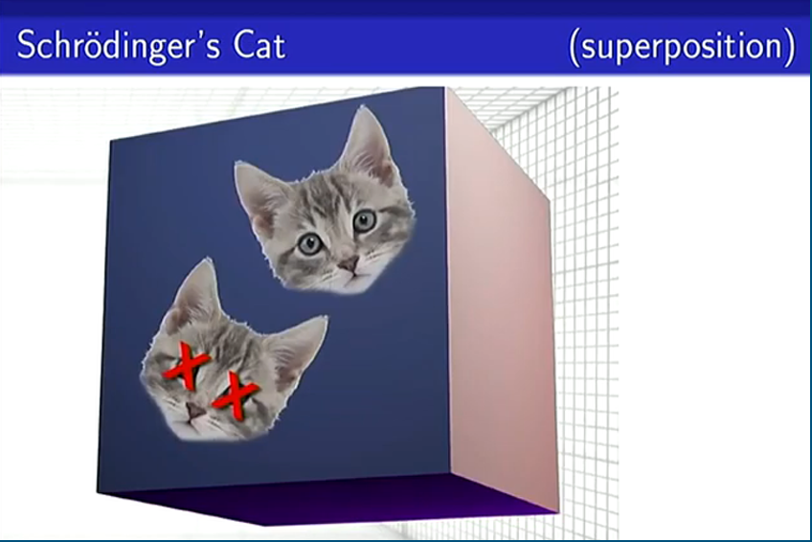

Slide 17
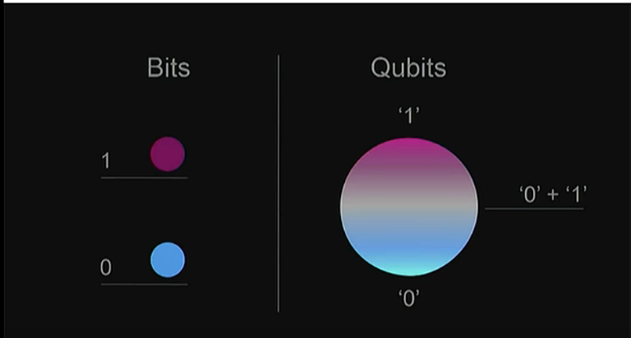
Bit vs. Qubit

Slide 18
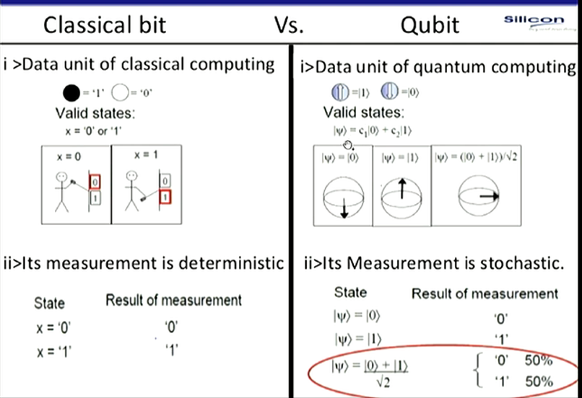
Classical bit Vs. Qubit

Slide 19
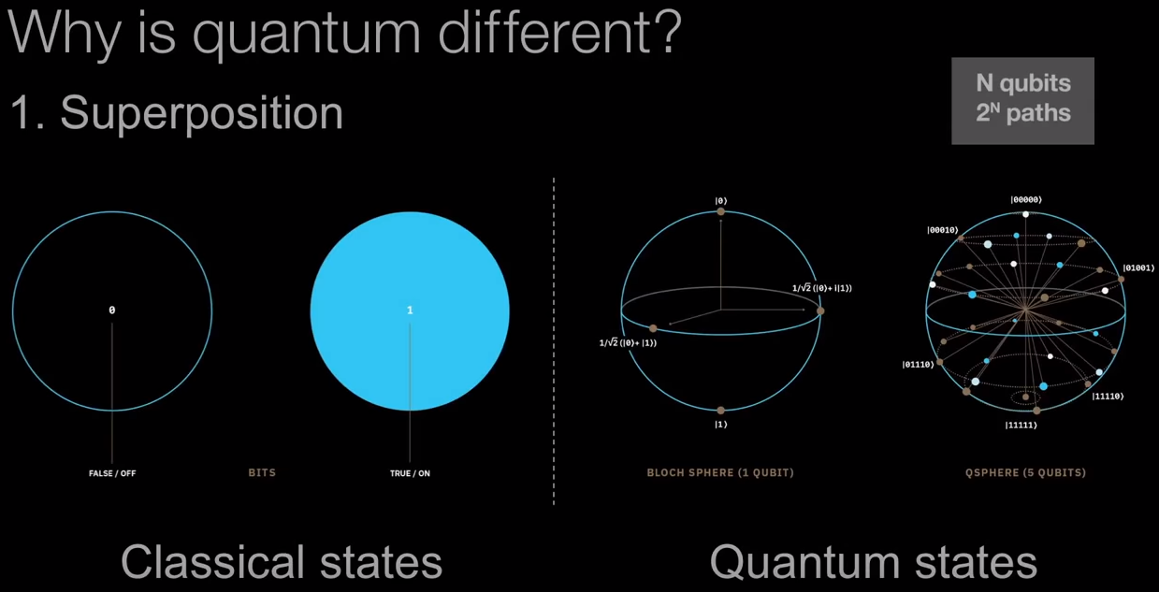

Slide 20
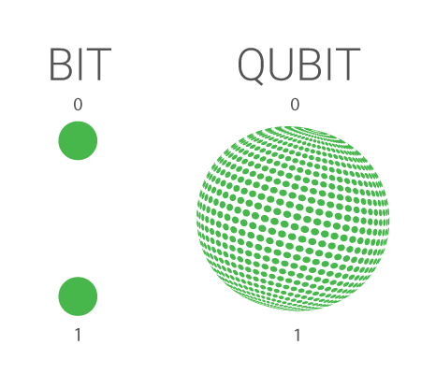
Classical Bit
vs
Qubit
The classical bit is the fundamental unit of classical computers; they can either be zero or one.
The qubit is the fundamental unit of quantum computers; they can be zero, one, or a combination.
X = 0 -> ‘0’
X = 1 -> ‘1’
Their measurement is deterministic.
|0⟩ -> ‘0’
|1⟩ -> ‘1’
|0⟩+|1⟩ -> 50% ‘0’
√2 50% ‘1’
Their measurement is stochastic.

Slide 21
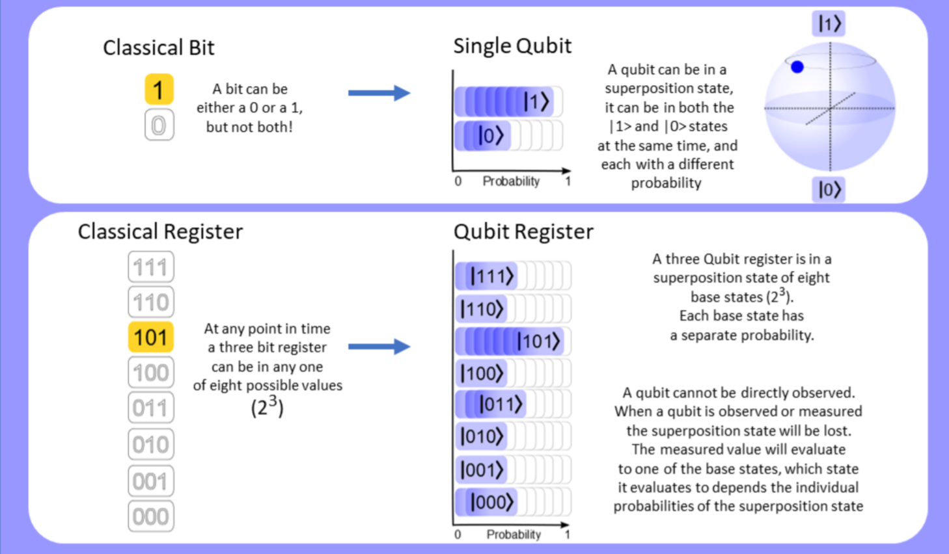
Qubit Register Superposition

Slide 22
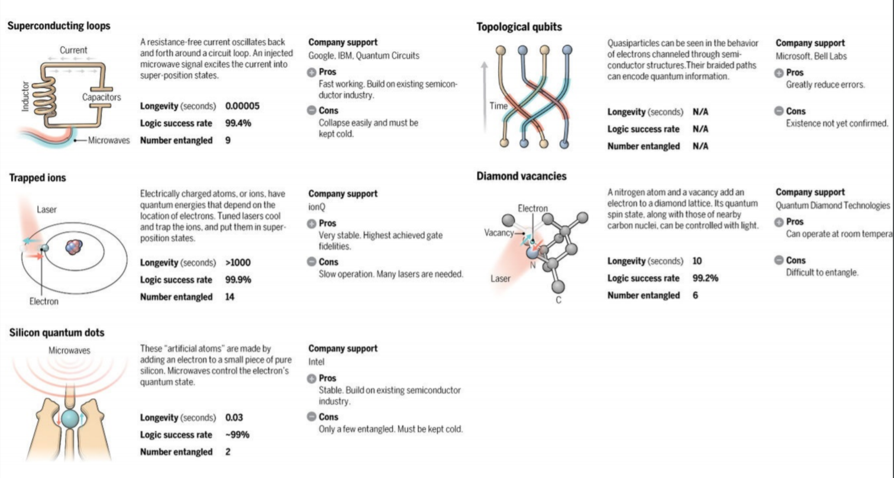
How to Build a Qubit

Slide 23
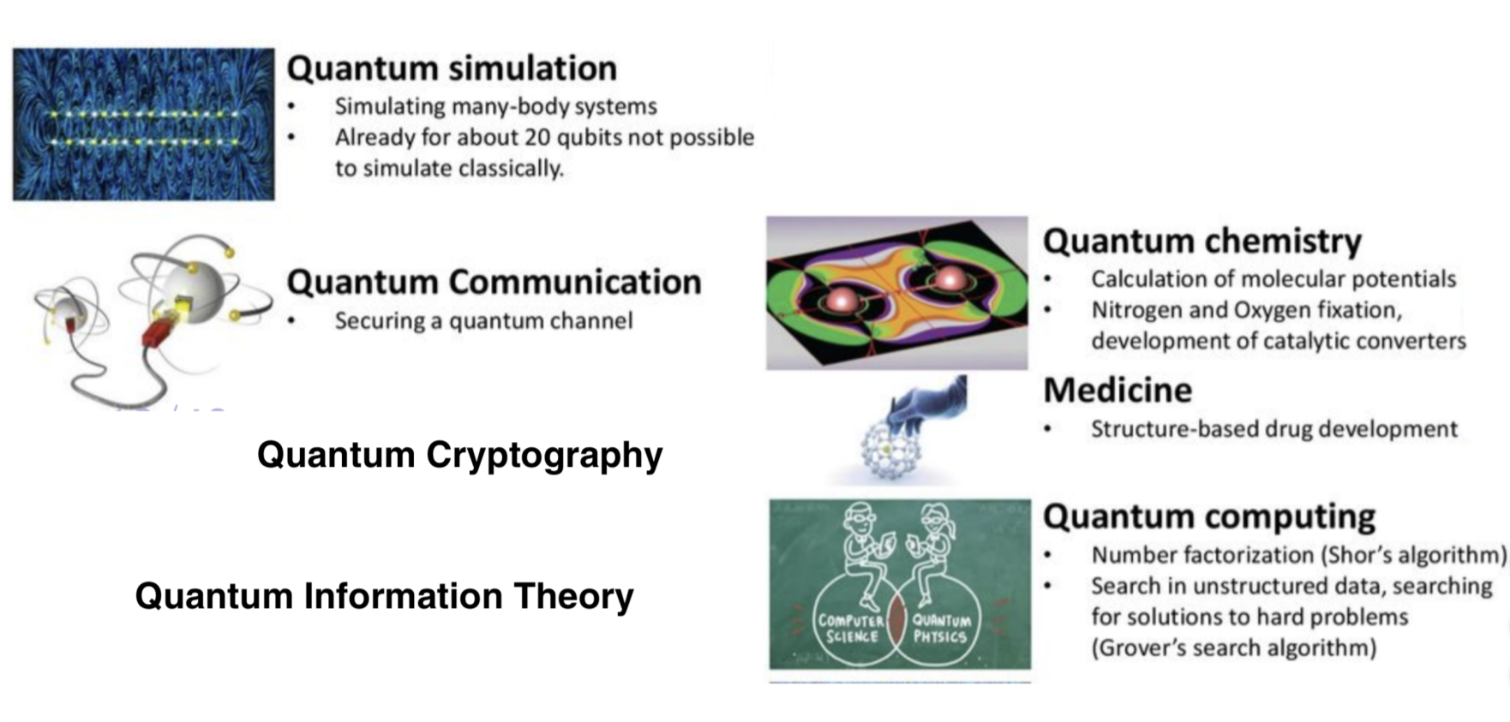
Quantum Computing ⊆ Quantum Informatics

Slide 24
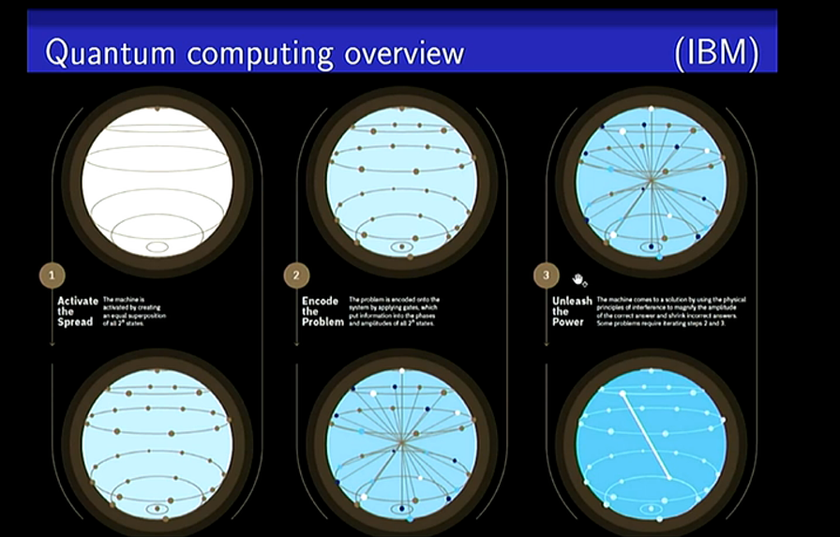

Slide 25
Shor’s Algorithm
Prime factorization is one computationally intensive task which can be accelerated by Quantum Computers.
Example: 343849431403363643 = 373578911 * 920419813
Classical: t ~ exp(O(n^{1/3} log^{2/3} n)) 28,000,000,000,000,000,000,000 years.
28 sextillion years.
2 trillion times longer than the age of the universe.
Quantum: t ~ O(n³) 100 seconds.

Slide 26
Quantum Computing Overview
Activate the Spread
The machine is activated by creating an equal superposition of all 2^{n} states.
2) Encode the Problem
The problem is encoded into the system using quantum gates.
3) Unleash the Power
The machine creates a solution by increasing the amplitudes of correct answers and decreasing amplitudes of incorrect ones.

Slide 27
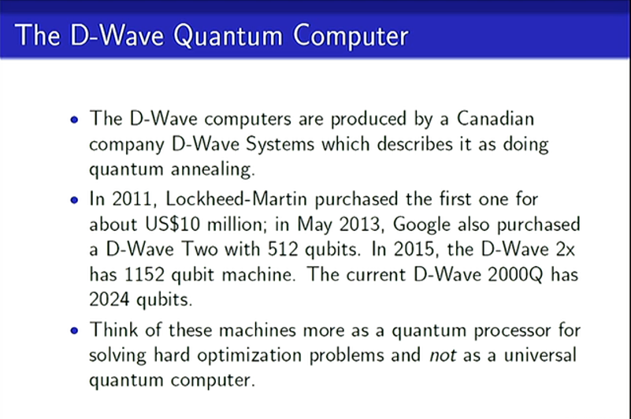

Slide 28
The D-Wave Quantum Computer
The D-Wave computers are produced by a Canadian company D-Wave Systems which describes it as doing quantum annealing.
In 2011, Lockheed-Martin purchased the first one for about US$10 million; in May 2013, Google also purchased a D-Wave Two with 512 qubits. In 2015, the D-Wave 2x has 1152 qubit machine. The current D-Wave 2000Q has 2024 qubits.
Think of these machines more as a quantum processor for solving hard optimization problems and not as a universal quantum computer.

Slide 29
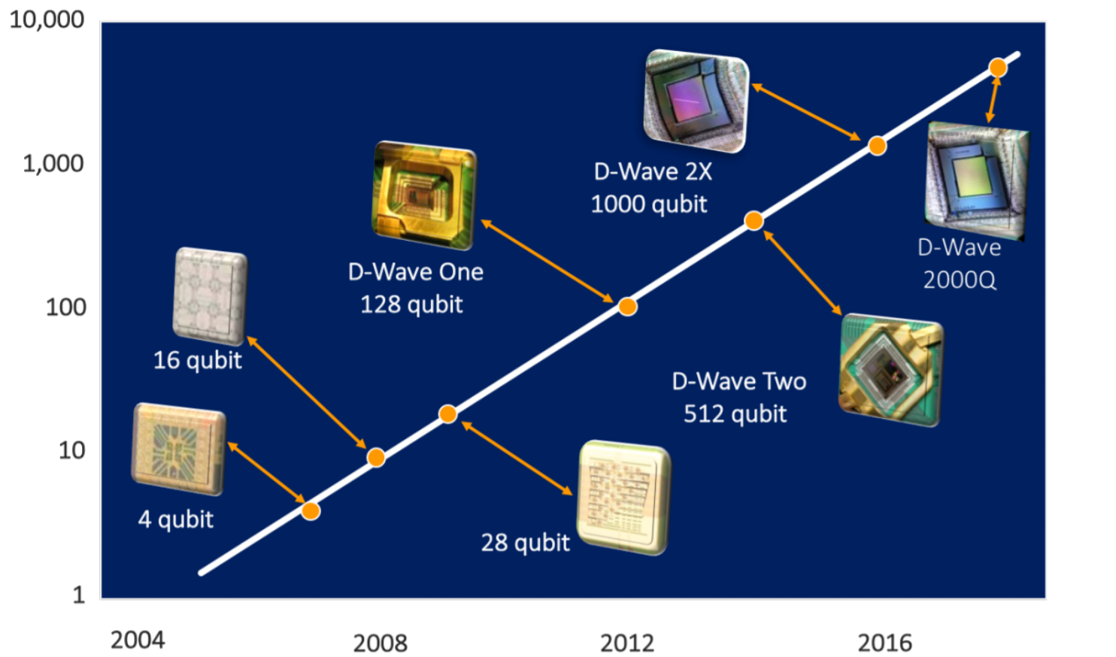
# Qubits
Year

Slide 30
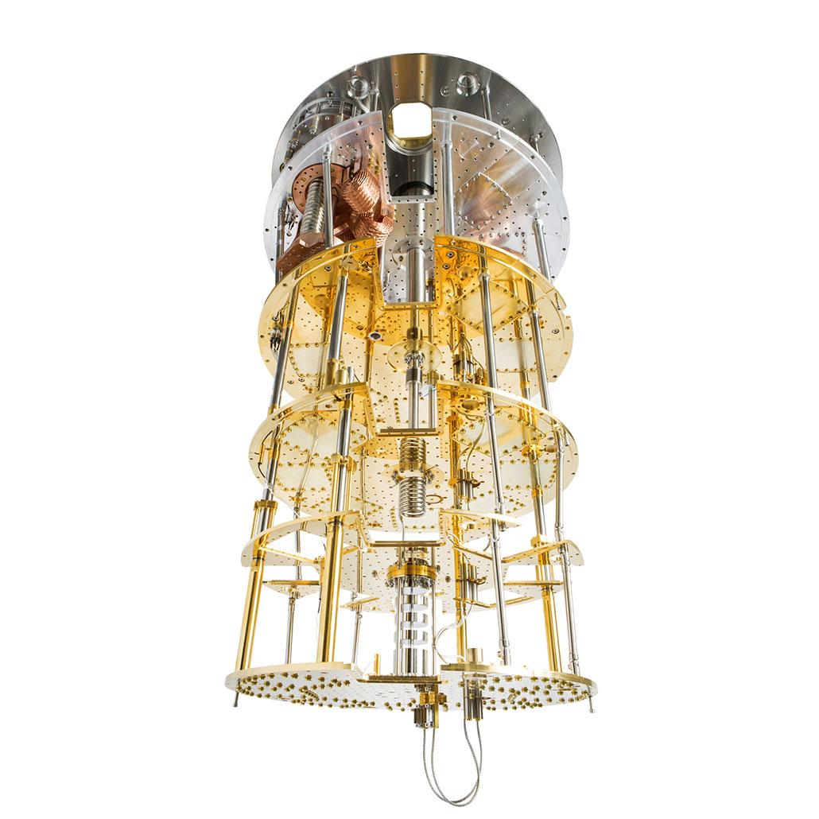
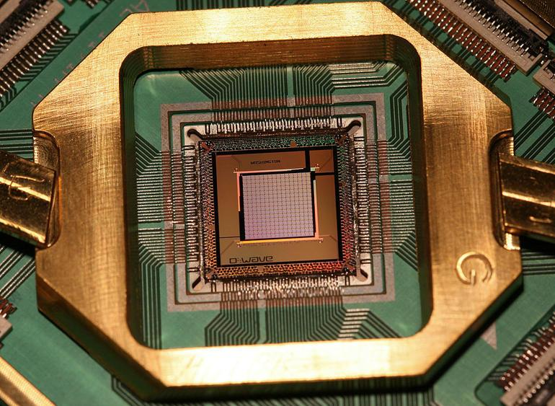
Dilution Refrigerator
Quantum Processor

Slide 31
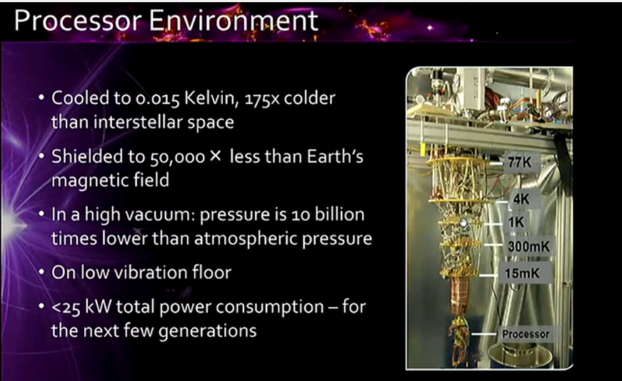

Slide 32
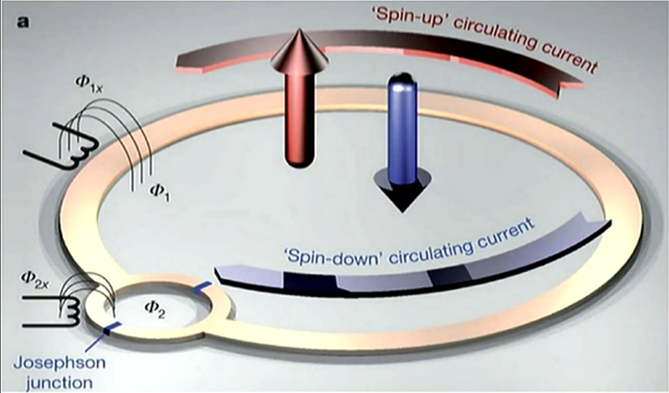
D-Wave

Slide 33
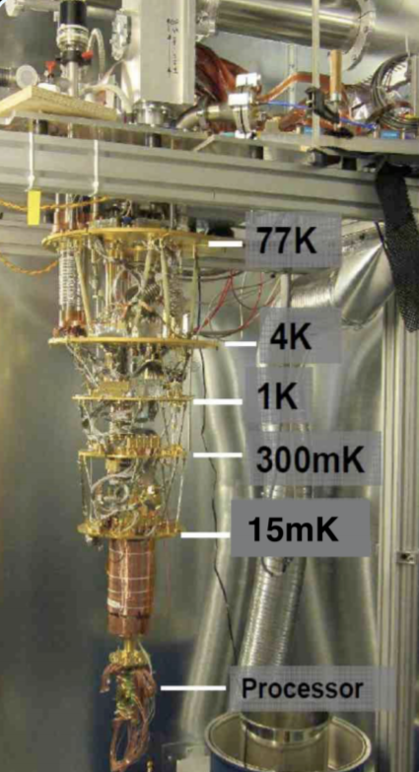
Processor Environment
The processor must be kept extremely cold - 0.015 Kelvin.
About 175 times colder than interstellar space.
Shielded from magnetic fields that are 50,000 times
weaker than Earth’s.
High vacuum - 10 billion times less pressure than outside
On a low vibration floor
Less than 25kW total power consumption

Slide 34
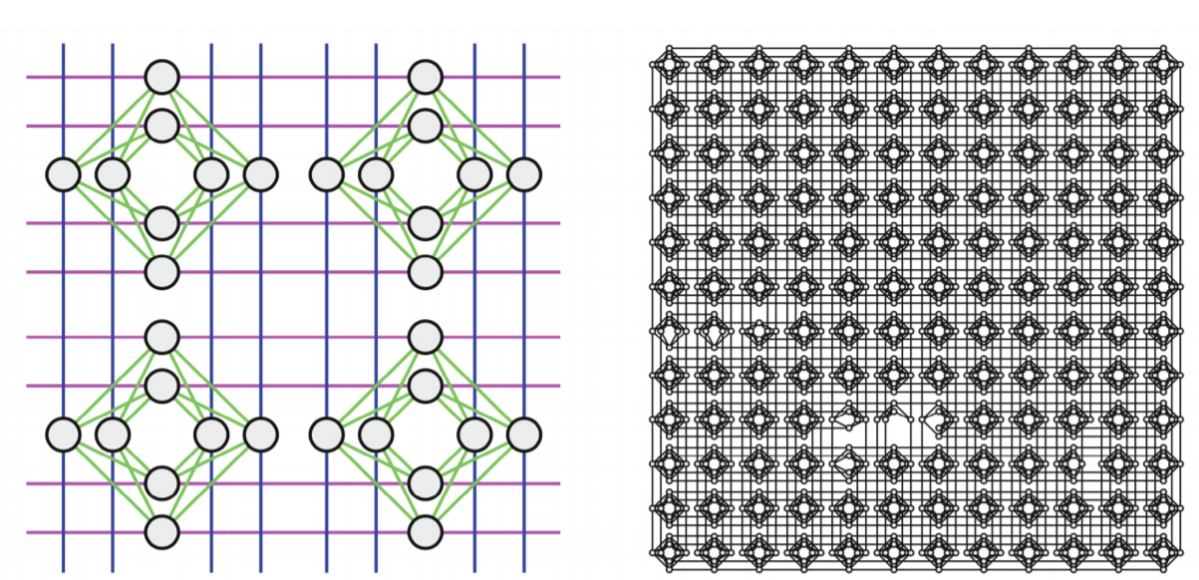
a) Zoomed in 2x2 grid of unit cells b) Chimera graph implemented by
LANL’s D-Wave System: Ising

Slide 35
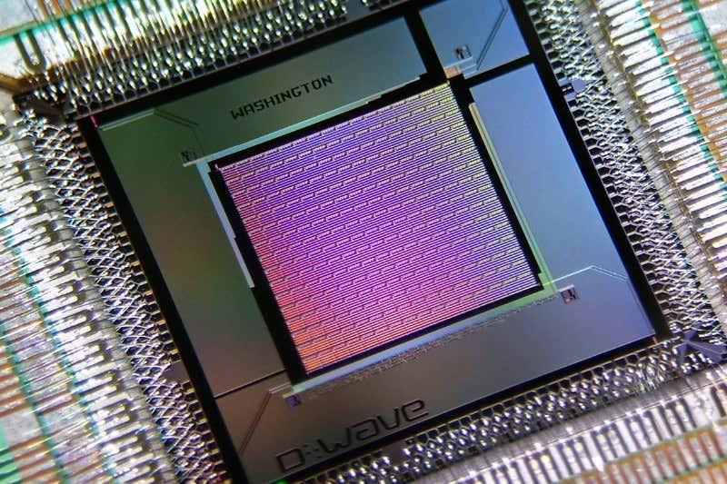
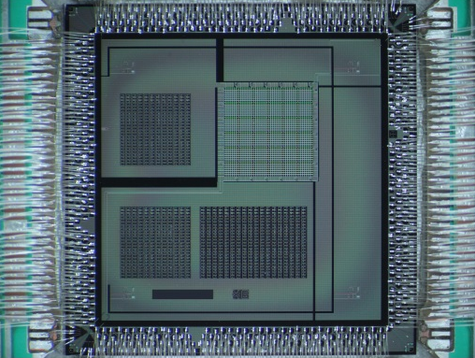
Next generation hardware significantly enhanced connectivity
Chimera C16 - DW 2000Q Pegasus P6 - 680 Qubit Prototype
Most significant architecture change since first processor D-Wave One.
Enabled by major technology changes in fabrication stack.
Have demonstrated P6 prototype.

Slide 36
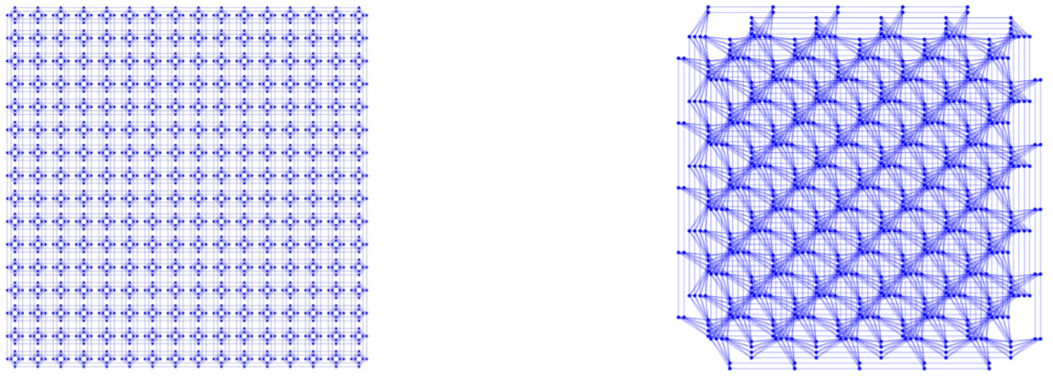
Pegasus architecture significantly enhances connectivity
Chimera C16 - DW 2000Q Pegasus P6 - 680 Qubit Prototype
Device Count C16 P6 P12 P16
Qubits 2048 680 3080 5640
Couplers 6000 4784 21764 40484
Max degree 6 15 15 15

Slide 37
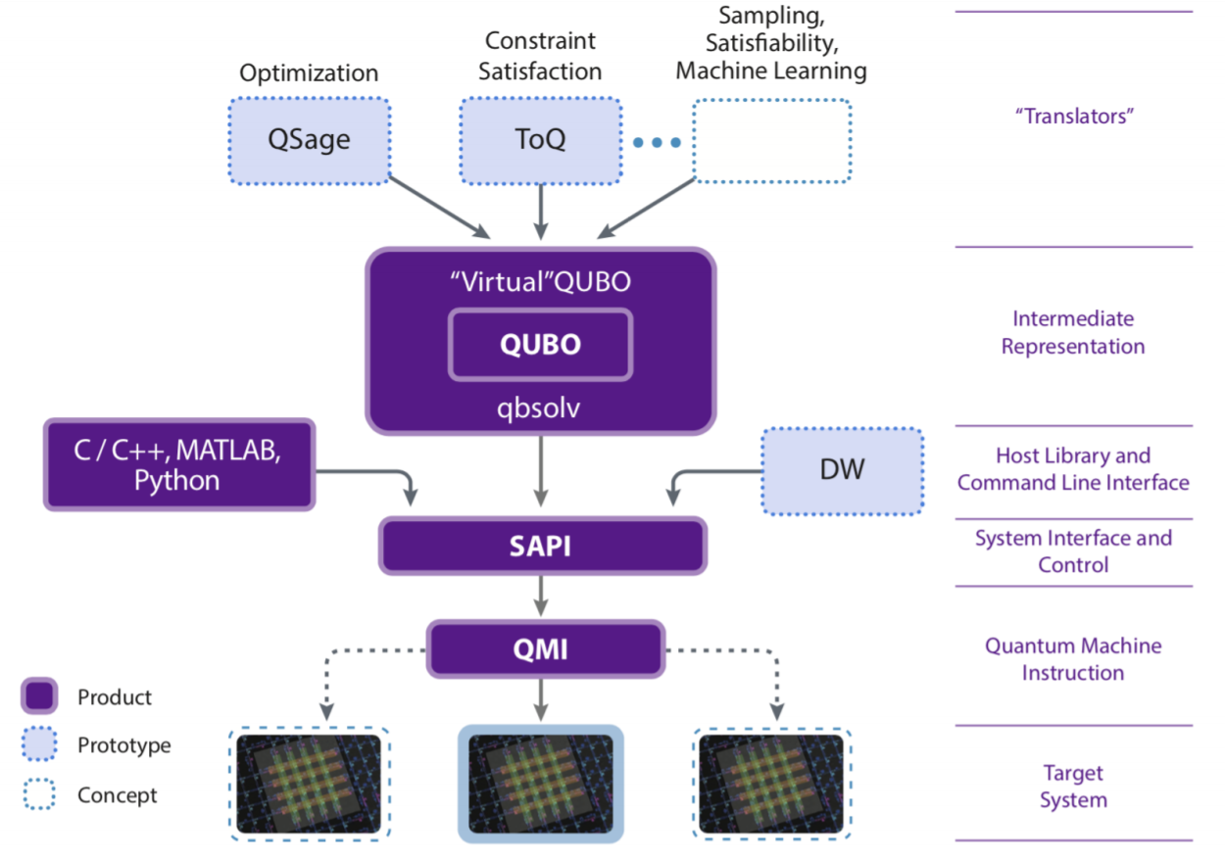
D-Wave Software Development

Slide 38
D-Wave System Capability
The Quantum Processing Unit (QPU) “solves” only the following NP-Hard
optimization problem.
Ising Binary Optimization:
Input: a vector h of length n, [h₁, h₂, … , h_{n}], and an n-by-n matrix J.
Output: a spin set s = [s₁, … , s_{n}] where s_{i} ∈ {-1, +1} that minimizes:
s* = min Σ h_{i}s_{i} + Σ J_{(i, j)}s_{i}s_{j}
This is its Quantum Machine Instruction (QMI).
n
s i=1 1≤i<j≤n

Slide 39
Extra Slides

Slide 40
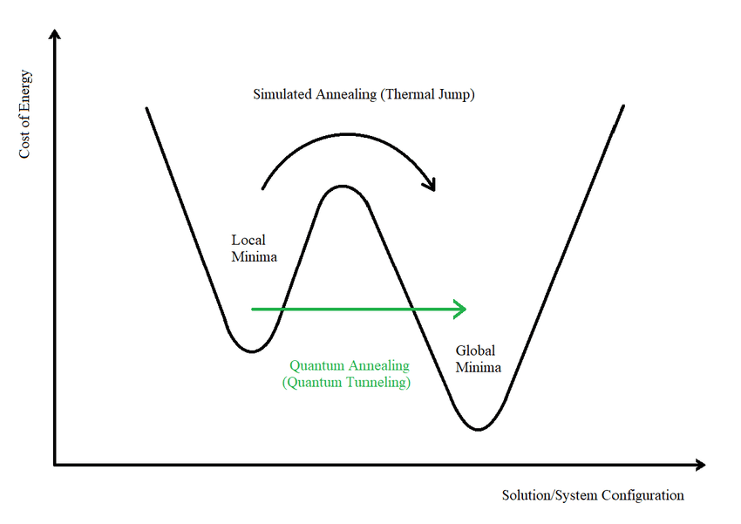
Quantum Annealing
Quantum Annealing uses “quantum fluctuations” instead of thermal fluctuations to get through high but thin barriers in the target function.
One may consider the variables in the problem to have classical degrees of freedom, and the cost functions to be a potential energy function.

Slide 41
Stages of Solving Optimization Problems
Mathematical formulation (Ising or QUBO)
Classical preprocessing
Embedding logical problem on physical hardware connectivity
Load input as initial state on quantum device
Execute quantum annealing on device (several times)
Read/collapse state to digital form
Classical postprocessing
Analyze results
If good, stop. Else return to 4. Possibly return to 1 if still doesn’t work.

Slide 42
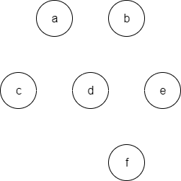
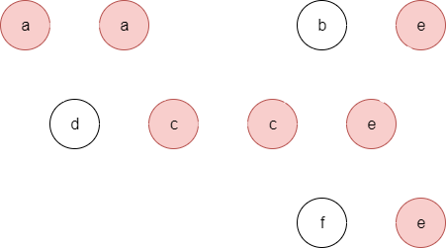
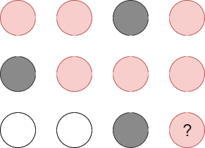
Minor Embedding Problem
We may need to map (embed) logical qubit interaction (couplers) to actual hardware qubit structure.
≤_{m}
≤_{m}

Slide 43
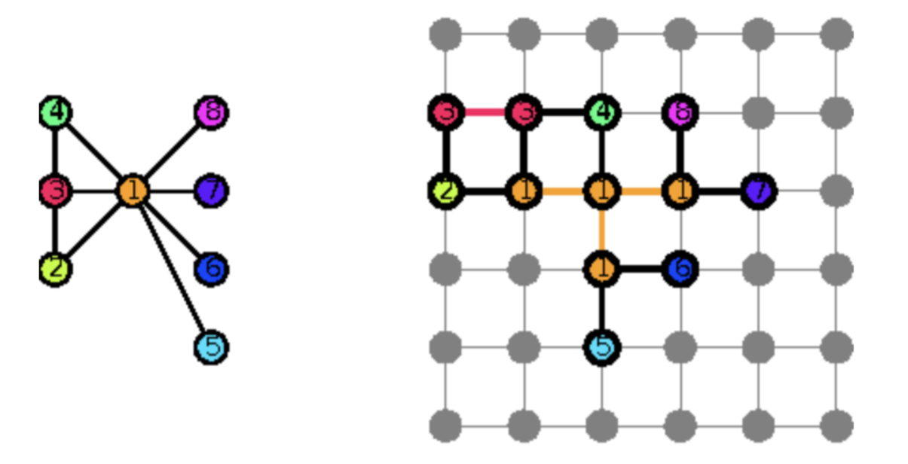
G
G_{emb}

Slide 44
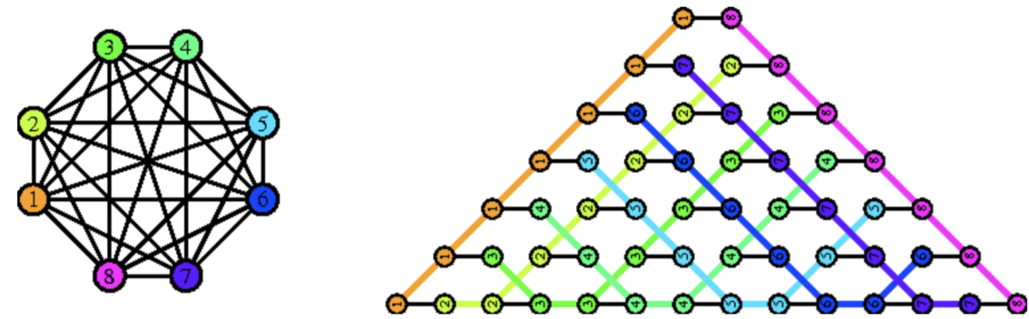

Slide 45
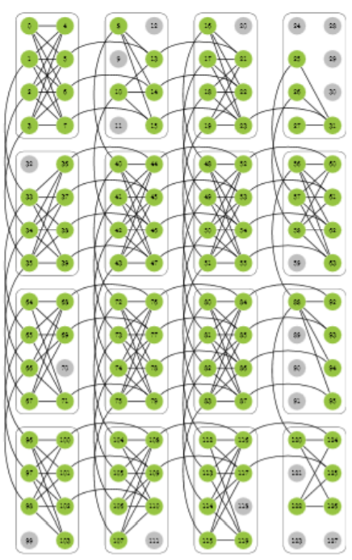
D-Wave Architecture: Chimera Graphs
A Chimera Graph consists of an MxN two dimensional lattice of blocks, with each block consisting of 2L variables for a total of 2MNL variables.
To index any qubit we use four numbers (i, j, u, k). (i, j) indexes the (row, column) of the block.
Qubits indexed by (i, j, u, k) and (i’, j’, u’, k’) are neighbors if and only if:
i = i’ and j = j’ and [(u, u’) = (0, 1) or (u, u’) = (1, 0)] OR
i = i’ ± 1 and j = j’ and u = u’ and u = 0 and k = k’ OR
i = i’ and j = j’ ± 1 and u = u’ and u = 1 and k = k’
The MxNxL Chimera graph is bipartite, non-planar and
has treewidth L · min(M, N)

Slide 46
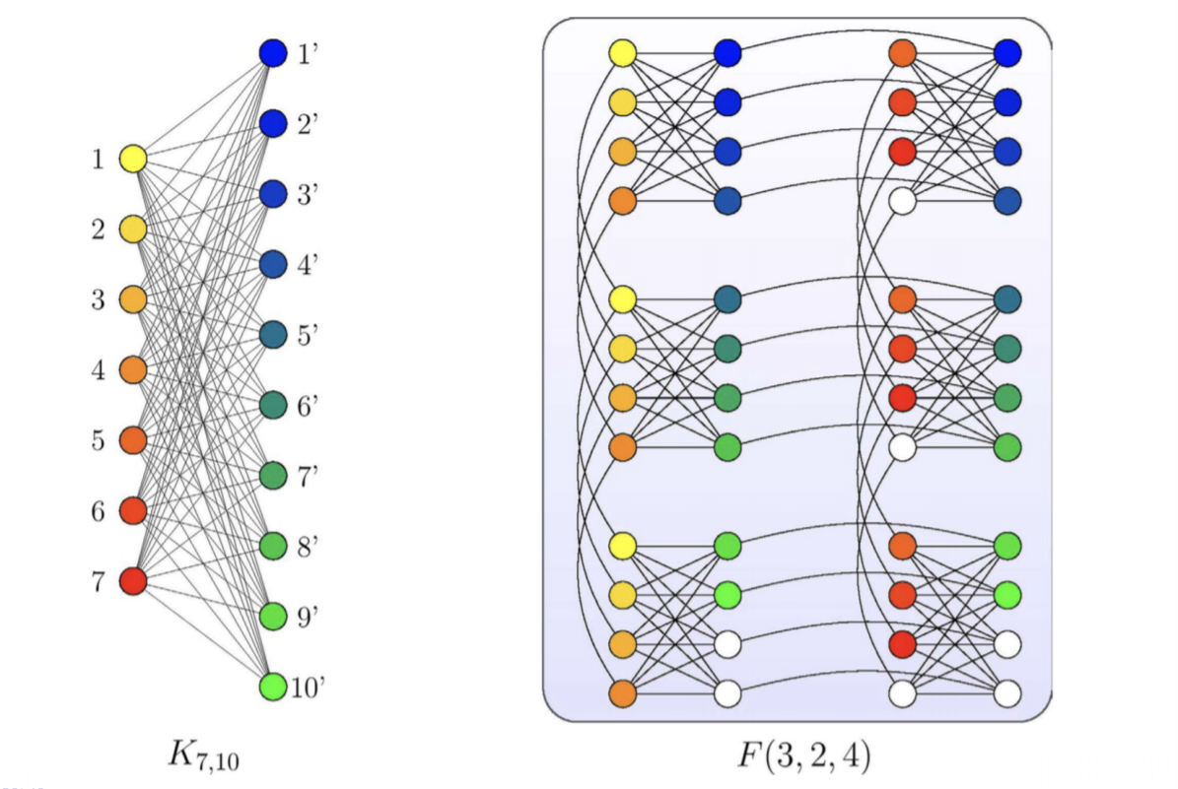

Slide 47
Basic Graph Embedding Statistics
C16 P6 P16
Complete Graph 64 (17) 60 (7) 180 (17)
Complete Bipartite 64x64 (16) 52x52 (5) 172x172 (15)
Cubic Lattice 8x8x8 (4) 5x5x12 (2) 15x15x12 (2)
Factoring Circuit 16-bit (16) 10-bit (5) 30-bit (15)
Grid with Diagonals 16x16 (6) 15x15 (6) 45x45 (6)
(max chain length in gray)

Slide 48
D-Wave System Solver
Only solves Ising binary optimization problems,
or equivalently, QUBO formulations.
Need to use classical digital computer to transform to this format
(in polynomial time).
Then embed/map structure to D-Wave hardware structure
(often heuristic algorithm).
Run several times to get good probabilistic answer.
Post-processing result on classical computer (in polynomial time).

Slide 49
Quadratic Unconstrained Binary Optimization
Quadratic Unconstrained Binary Optimization (QUBO) is an NP-Hard mathematical optimization problem of minimizing a quadratic objective function z = x^{T}Qx, where x is an n-vector of binary variables and Q is an upper-triangular n-by-n matrix. Formally, QUBO problems are in this form:
x* = min Σ x_{i}Q_{(i, j)}x_{j} , where x_{i} ∈ {0, 1}.
QUBO is a special case of Quadratic Programming, where linear constraints may be present, and the variables need not to be discrete. Note terms linear in x_{i} arise from the diagonal contribution of Q since Q_{(i, j)}x_{i}² = Q_{(i, j)}x_{i} for binary x_{i} .
x i≤j

Slide 50
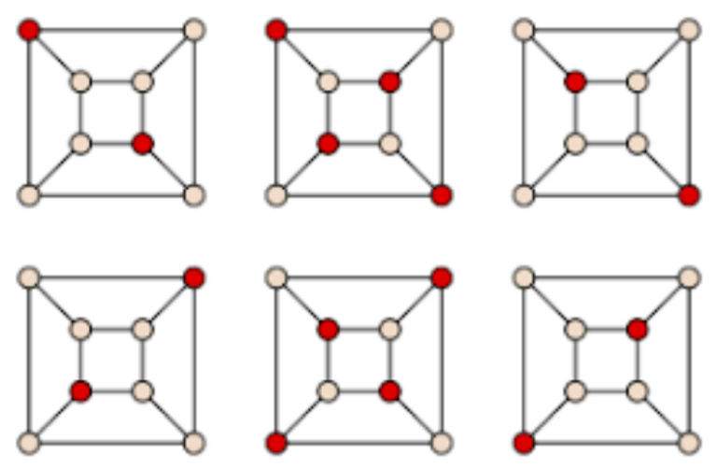
Graph Example: Maximum Independent Set
Definition:
Given a graph G = (V, E) where V is a set of vertices and E is a set of edges connecting vertices. A set of vertices V’ ⊆ V is an independent set if there are no edges connecting any pair of vertices of V’ .

Slide 51
QUBO Example: Maximum Independent Set
For a graph G = (V, E) we want a to create a minimization objective function z where we consider all possible subsets of a n-vector x of length n = |V|.
We take x_{i} = 1 if and only if i ∈ V is selected as an element of a potential independent set.
We can constrain the maximum number (and legality) of variables x_{i} = 1 by giving a big penalty for any edge (u, v) ∈ E and both x_{u} = x_{v} = 1.
Q_{(i, j)} =
{
-1 if i = j
≥2 if i < j and (i, j) ∈ E

Slide 52
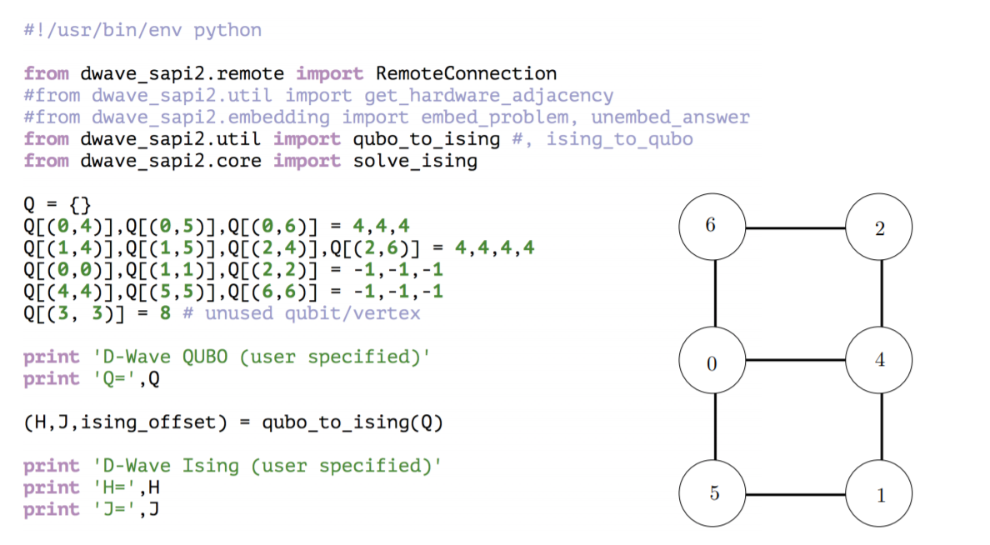
D-Wave Example: Max Ind Set (program)

Slide 53
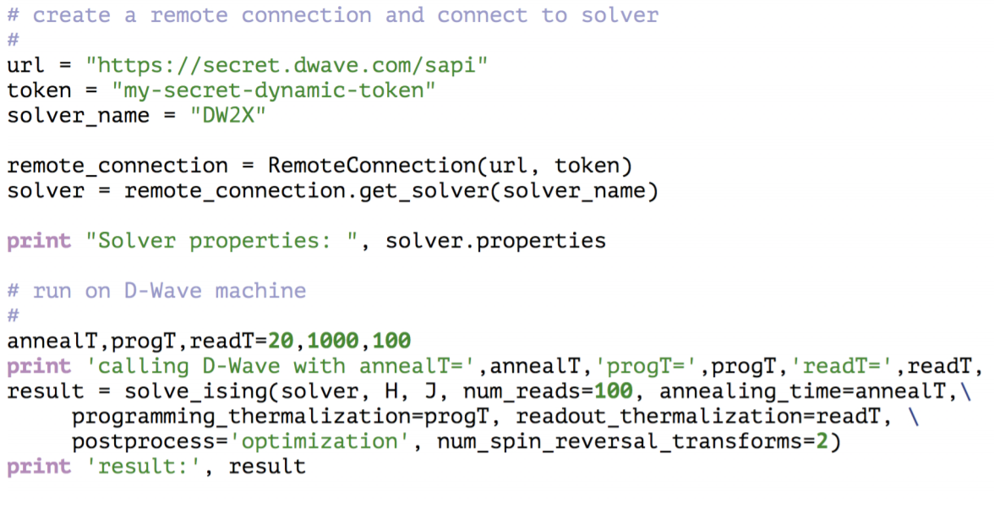
D-Wave Example: Max Ind Set (program) cont.

Slide 54
D-Wave Example: Max Ind Set (output)
D-Wave QUBO (user specified)
Q= {(2, 6): 4, (6, 6): -1, (5, 5): -1, (1, 5): 4, (2, 2): -1, (4, 4): -1, (1, 4): 4, (1, 1): -1, (0, 6): 4, (0, 0): -1, (0, 5): 4, (0, 4): 4, (2, 4): 4, (3, 3): 8}
D-Wave Ising (user specified)
H= [2.5, 1.5, 1.5, 4.0, 2.5, 1.5, 1.5] J= {(2, 6): 1.0, (1, 5): 1.0, (1, 4): 1.0, (0, 6): 1.0, (0, 5): 1.0, (0, 4): 1.0, (2, 4): 1.0}
Solver properties: {’chip_id’: ’DW2X’, ’num_qubits’: 1152, ’num_reads_range’: [1, 10000], ’max_anneal_schedule_points’: 2, ’anneal_offset_step’: 0, ’programming_thermalization_range’: [0, 10000], ’parameters’: {’num_spin_reversal_transforms’: ’’, ’reduce_intersample_correlation’: ’A boolean for whether to add pauses between samples.’, ’programming_thermalization’: ’An integer that gives the time (in microseconds) to wait after programming the processor in order for it to cool back to base temperature..’, ’reinitialize_state’: ’Whether to reapply the initial_state for every read.’, ’anneal_offsets’: ’A list of anneal offsets for each working qubit (NaN if unused).’, ’num_reads’: ’’, ’max_answers’: ’’, ’readout_ thermalization’: ’An integer that gives the time (in microseconds) to wait after each state is read from the processor in order for it to cool back to base temperature.’, ’flux_biases’: ’A list of flux biases for each working qubit.’, ’beta’: "Boltzmann distribution parameter. Only used when postprocess is set to ’sampling’.", ’answer_mode’: ’’, ’auto_scale’: ’’, ’postprocess’: "either ’sampling’ or ’optimization’", ’annealing_time’: ’A positive integer that sets the duration (in microseconds) of quantum annealing time.’, ’anneal_schedule’: ’A piecewise linear annealing schedule specified by a list of points.’, ’initial_state’: ’The initial states to use for the reverse anneal feature.’, ’chains’: "Defines which qubits represent the same logical variable (or ’chain’) when postprocessing is enabled.", ’flux_drift_compensation’: ’A boolean for whether to activate the flux drift compensation.’}, ’extended_j_range’: [-1, 1], ’annealing_time_range’: [5, 2000], ’h_range’: [-2, 2], ’default_programming_thermalization’: 1000, ’anneal_offset_step_phi0’: 0, ’couplers’: [[0, 4], [1, 4], [2, 4], [3, 4], ....

Slide 55
D-Wave Example: Max Ind Set (output) cont.
Run 1:
calling D-Wave with annealT= 20 progT= 1000 readT= 100 result: {’timing’: {’total_real_time’: 86610, ’anneal_time_per_run’: 20, ’post_processing_overhead_time’: 20226, ’qpu_sampling_time’: 47050, ’readout_time_per_run’: 309, ’qpu_delay_time_per_sample’: 141, ’qpu_anneal_time_per_sample’: 20, ’total_post_processing_time’: 20226, ’qpu_programming_time’: 34689, ’run_time_chip’: 47050, ’qpu_access_time’: 86610, ’qpu_readout_time_per_sample’: 309}, ’energies’: [-11.0, -11.0], ’num_occurrences’: [42, 58],
’solutions’: [[-1, -1, -1, -1, 1, 1, 1, 3, 3, 3, 3, 3, 3, ..., 3, 3, 3, 3, 3, 3], [1, 1, 1, -1, -1, -1, -1, 3, 3, 3, 3, 3, 3, ..., 3, 3, 3, 3, 3, 3]])
Run 2:
calling D-Wave with annealT= 20 progT= 1000 readT= 100 result: {’timing’: {’total_real_time’: 85915, ’anneal_time_per_run’: 20, ’post_processing_overhead_time’: 12069, ’qpu_sampling_time’: 47050, ’readout_time_per_run’: 309, ’qpu_delay_time_per_sample’: 141, ’qpu_anneal_time_per_sample’: 20, ’total_post_processing_time’: 12069, ’qpu_programming_time’: 34688, ’run_time_chip’: 47050, ’qpu_access_time’: 85915, ’qpu_readout_time_per_sample’: 309}, ’energies’: [-11.0, -11.0], ’num_occurrences’: [46, 54],
’solutions’: [[-1, -1, -1, -1, 1, 1, 1, 3, 3, 3, 3, 3, 3, ..., 3, 3, 3, 3, 3, 3], [1, 1, 1, -1, -1, -1, -1, 3, 3, 3, 3, 3, 3, ..., 3, 3, 3, 3, 3, 3]])

